Slide 1

Compensation Plan
How you get paid

Slide 2
Unilevel
You
Level 1
8%
Level 2
5%
Unilevel is the base commission. It is based off a the volume from a specific level.
You can earn up to a max of 5 levels of unilevel.
Level 1 – 8%
Level 2 – 5%
Levels 3-5 – 4%

Slide 3
Unilevel
You
In order to earn unilevel you need at least 100 PV.
100 PV
Level 1
100 PV
100 PV
100 PV
8%
Level 2
100 PV
5%
The levels are based off of how many members are in a line. With the exception of Compression.
Notes:
In order to earn unilevel commission you must have at least 100 PV for the month. Some one with a 100 PV order can earn the first 2 levels of unilevel. Star earns 1st-3rd, Senior Start earns 1st-4th, and Executive and above earn 1st-5th.

Slide 4
Unilevel
You
100 PV
Level 1
100 PV
50 PV
100 PV
8%
100 PV
Level 2
100 PV
100 PV
5%
Compression happens when there is a member without a 100 PV order and someone under them has at least 100 PV.
Notes:
In order to earn unilevel commission you must have at least 100 PV for the month. Some one with a 100 PV order can earn the first 2 levels of unilevel. Star earns 1st-3rd, Senior Start earns 1st-4th, and Executive and above earn 1st-5th.

Slide 5
Unilevel
You
100 PV
Level 1
100 PV
50 PV
100 PV
8%
50 PV
5%
Level 2
100 PV
In the event no one is that line has a 100 PV order, that entire leg is considered your unilevel 1.
Notes:
In order to earn unilevel commission you must have at least 100 PV for the month. Some one with a 100 PV order can earn the first 2 levels of unilevel. Star earns 1st-3rd, Senior Start earns 1st-4th, and Executive and above earn 1st-5th.

Slide 6
Enrollment Bonuses
Fast Start
You
In order to earn Fast Start you need a minimum 50 PV.
Enroller
100 PV
Fast Start bonus has two parts.
First is the 25% of your enrollee’s orders for the first 3 months.
New Member
100 PV
In this instance that would be an earnings of $25 just for that!
*This portion of Fast Start has a cap of $200 per new member.

Slide 7
Enrollment Bonuses
Fast Start
You
100 PV
Lets go over how it works.
Fast Start bonus has two parts.
You will earn the 10% of Sam only if Jan earns the 25%.
In this case Jan meets the minimum 50 PV requirement. That means you earn $10 from Sam’s order.
The second is 10% of your enrollee’s new enrollee’s first 3 months orders.
You enroll Jan.
100 PV
Jan enrolls Sam 1 year later.
100 PV
* There is a cap of $80 per member for this portion.
*Whenever Fast Start is paid out, the volume of that new member is cut by 70% for all other commissions.

Slide 8
Enrollment Bonuses
Fast Start
*Whenever Fast Start is paid out, the volume of that new member is cut by 70% for all other commissions.
You
100 PV
This means rather than earning off of 100 PV for Sam, you earn off of 30 PV for all other commissions.
Jan
100 PV
8% * 100
Sam
100 PV
5% * 30

Slide 9
Enrollment Bonuses
Premium Starter Kit Bonus
You
In order to earn this bonus you need a minimum 50 PV.
The starter kit bonus is earned when your new enrollee starts with a premium starter kit.
Enroller
100 PV
New Member
100 PV
This bonus pays out $25 per new enrollee with a premium starter kit purchased in their first calendar month!

Slide 10
Rising Star Bonus
You
Rising Star is a structure based bonus. There are three parts to structure.
100 PV ER
100 PV ER
100 PV ER
100 PV ER
First is achieving 3 legs with 300 OGV each. You and the members you personally sponsored need to have 100 PV on Essential Rewards.
300 OGV
300 OGV
300 OGV
Completing this structure gets you 1 share. Shares vary around $30 - $50. The shares are based off of 1% of Young Living’s Commissionable Sales each month.

Slide 11
Rising Star Bonus
The second part is to maintain 3 legs at 300 OGV and have 2 at 500 OGV.
You
100 PV ER
100 PV ER
100 PV ER
100 PV ER
100 PV ER
100 PV ER
500 OGV
300 OGV
300 OGV
300 OGV
500 OGV
Completing this portion gets you 3 shares.

Slide 12
Rising Star Bonus
The third part is get maintain the 3 at 300 OGV, the 2 at 500 OGV, and then get 2 at 1,000 OGV.
100 PV ER
1,000 OGV
500 OGV
300 OGV
300 OGV
300 OGV
500 OGV
1,000 OGV
Remember, everyone you personally sponsor for this structure must have 100 PV on Essential Rewards.
Completing the entire structure gets you 6 shares.
* This is the only payout that requires Essential Rewards.
* The shares cannot be earned out of order.
* This program is for Star – Executive and can only be earned for 24 months.
Notes:
Once you qualify for any part of this program, your 24 month period starts. This means if you are an Executive and reach part of this structure that starts your clock. If the next month you hit Silver your clock is still running even though a Silver cannot earn these shares.

Slide 13
PGV
PGV (Personal Group Volume) is a qualification requirement for Silvers and above. PGV cuts in two places.
1st Your legs qualifying you for a rank will not count towards your PGV. That means when trying to reach Silver, your two highest legs will not count towards your 1000 PGV requirement.
2nd Silvers and above cut from your PGV as well. That means if you have a Silver outside of your qualifying legs, their OGV will be cut from your PGV.

Slide 14
Leg Qualification
What is a leg?
Each person you personally sponsor can become a new leg.
You
Leg 1
Leg 2
Leg 3
Notes:
Leg - Each person that your personally sponsor becomes a new leg. For qualification purposes, the leg is defined as the first member in that line with a 100PV or above order.
Level – A level is based on how many sponsors there are in a leg.

Slide 15
Leg Qualification
What is a leg?
Each person you personally sponsor can become a new leg.
You
Leg 1
50 PV
Leg 3
100 PV
Leg 2
100 PV
100 PV
A leg is also defined as the first member in that line with a 100PV or above order.
Notes:
Leg - Each person that your personally sponsor becomes a new leg. For qualification purposes, the leg is defined as the first member in that line with a 100PV or above order.
Level – A level is based on how many sponsors there are in a leg.

Slide 16
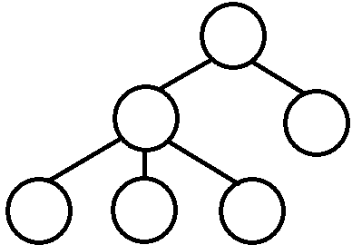
Let’s look at how that can affect you.
In this example your personally sponsored member did not order 100 PV and the three below them did. That means that each one of those rolls up and count as a leg for you.
50 PV
100 PV
1000 OGV
100 PV
100 PV
100 PV
1000 OGV
So rather than having a second 1000 OGV leg, you now have 3 more legs with smaller OGV.
Leg 4
500 OGV
300 OGV
200 OGV
Leg 1
Leg 2
Leg 3

Slide 17

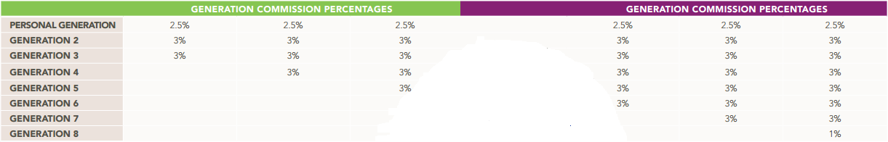
Generations
Generation- A generation is defined as a Silver down to but not including the next Silver or above.
What???

Slide 18
Let’s look at what that really means.
In this example you are a Silver.
And you have two Silvers under you.
Si
Si
Si

Slide 19
To start we are going to define the generations by going down to the first Silver or above in each leg.
Take these Silvers and their teams and they are your Generation 2.
Si
Si
Si
Gen. 2 3%
Gen. 2 3%

Slide 20
Everyone else, including yourself, are in your Personal Generation.
Personal Gen. 2.5%
Si
Si
Si
Gen. 2 3%
Gen. 2 3%
Let’s look at one more example.

Slide 21
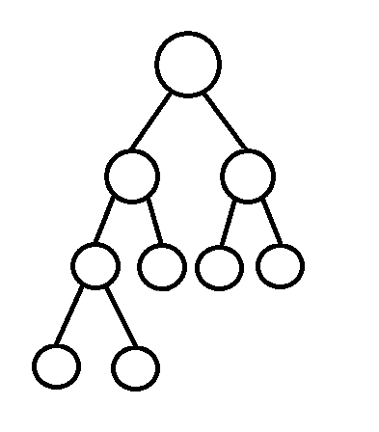
In this example we are looking at your main legs and there are 3 Silvers in your team.
We’re going to do the same thing and define the Generations by going down to the first Silver or above in each leg.
Next look for any Silvers under them. In this case there is one.
Personal Gen.
Si
That leaves you and the rest of your legs in your personal generation.
Gen. 2
Si
Si
Si
Gen. 3

Slide 22
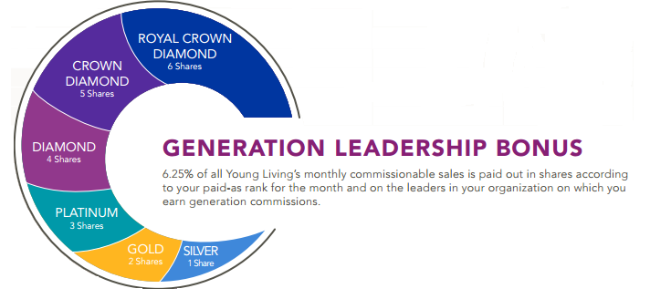
Generation Leadership Bonus
Two things to note: 1st You cannot earn more shares than you are in rank. 2nd You can only earn shares off of the Generations you are earning.

Slide 23
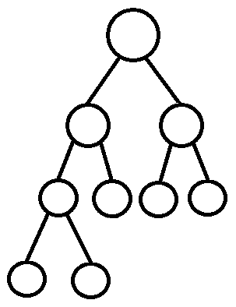
To start with Generation Leadership Bonus we need to look at your rank. That determines how many shares you can earn from each Silver and above.
Next count your generations. In this case you have down to Gen. 4. As a Silver you can only earn down to Gen. 3 so the Gen. 4 will be missed out on.
Now we count the shares! One for yourself and 3 from the Generations that you earn off of.
Si
1
That’s 4 shares that range from $130 - $160 each!
1
Si
Si
1
Note that even though a Gold is worth 2 shares, you only earn one because you are Silver.
1
Gld
Si

Slide 24
Transitioning to Being a Leader
What changes in your business?
You start focusing on your builders rather than sign ups.
You spend more time with your builders.
What changes in your commissions?
Less Fast Start
More Generations/Generations Leadership Bonus
What are the benefits?
Moving into financial abundance.
Helping family and friends grow and find success.

Slide 25
Now you know how you get paid!

