Slide 1
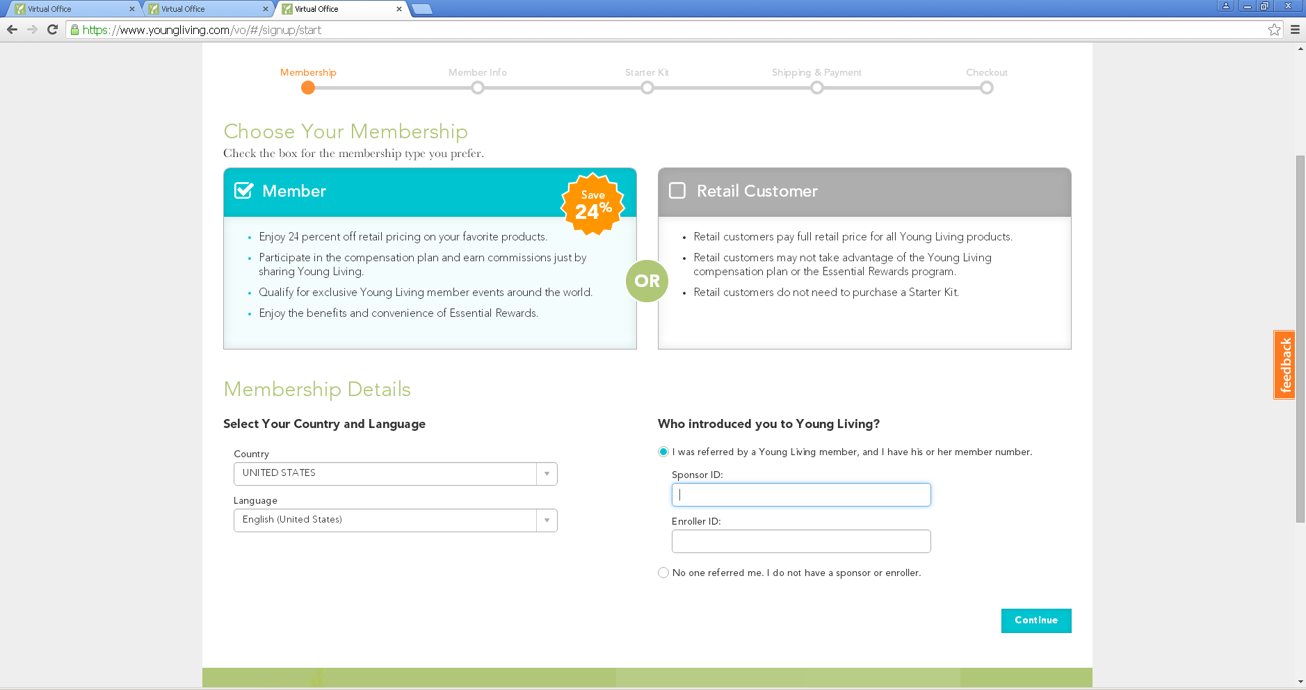
Enrollment Process on New VO
Go to www.youngliving.com
Click on become a member
Select membership type
When choosing member please enter your sponsor ID number and Enroller ID number
When done click on continue.

Slide 2
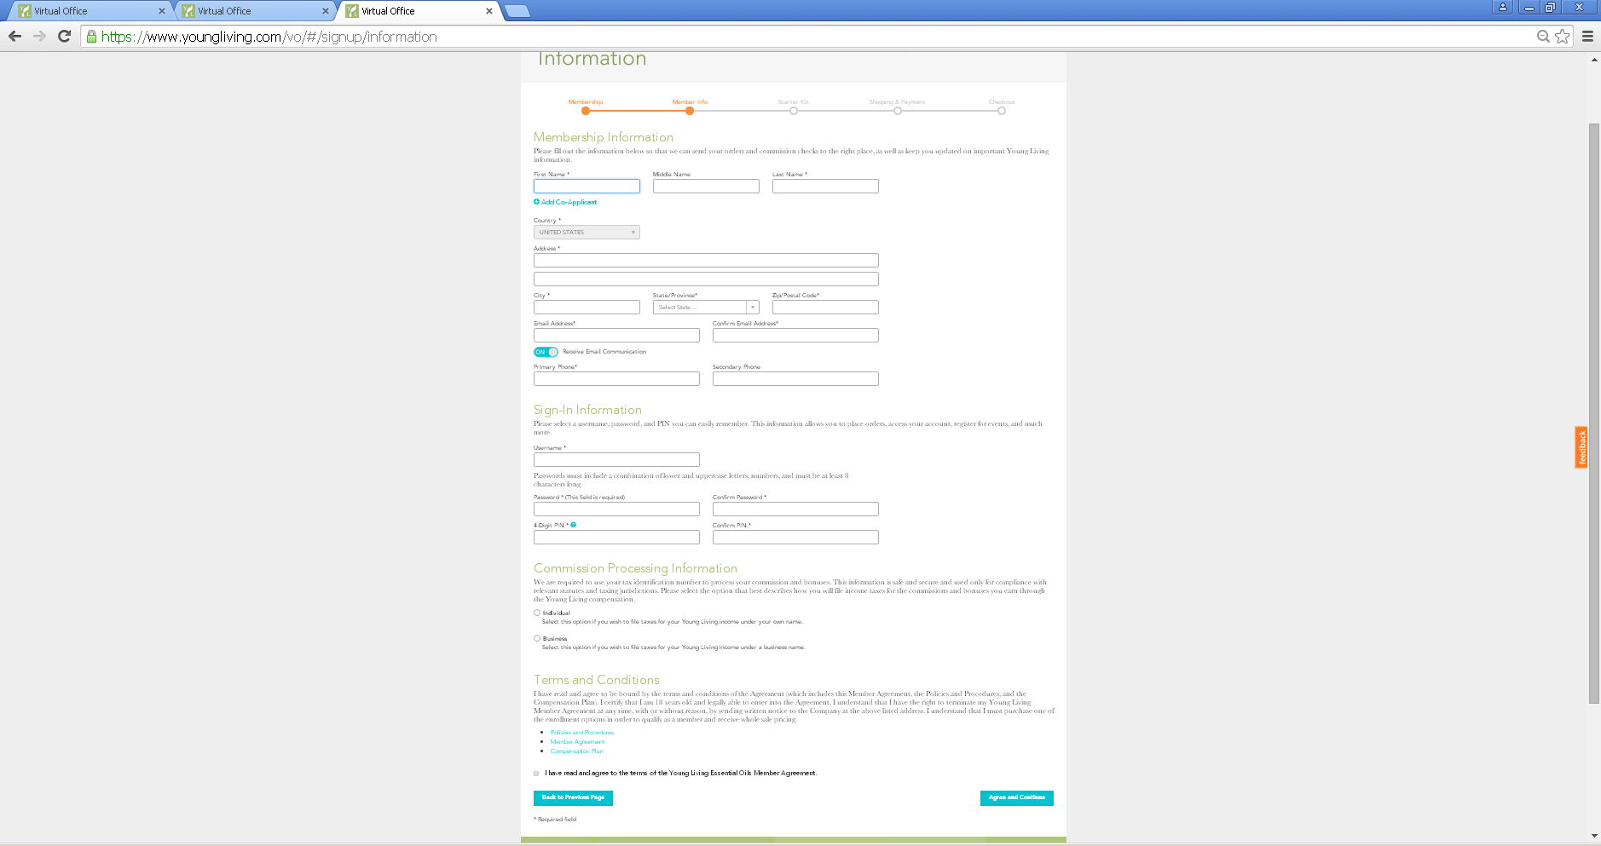
Fill out the information marked with an asterisk
Remember to click the check box at the bottom below TERMS and CONDITIONS.
Once you are done click NEXT at the bottom right corner.

Slide 3
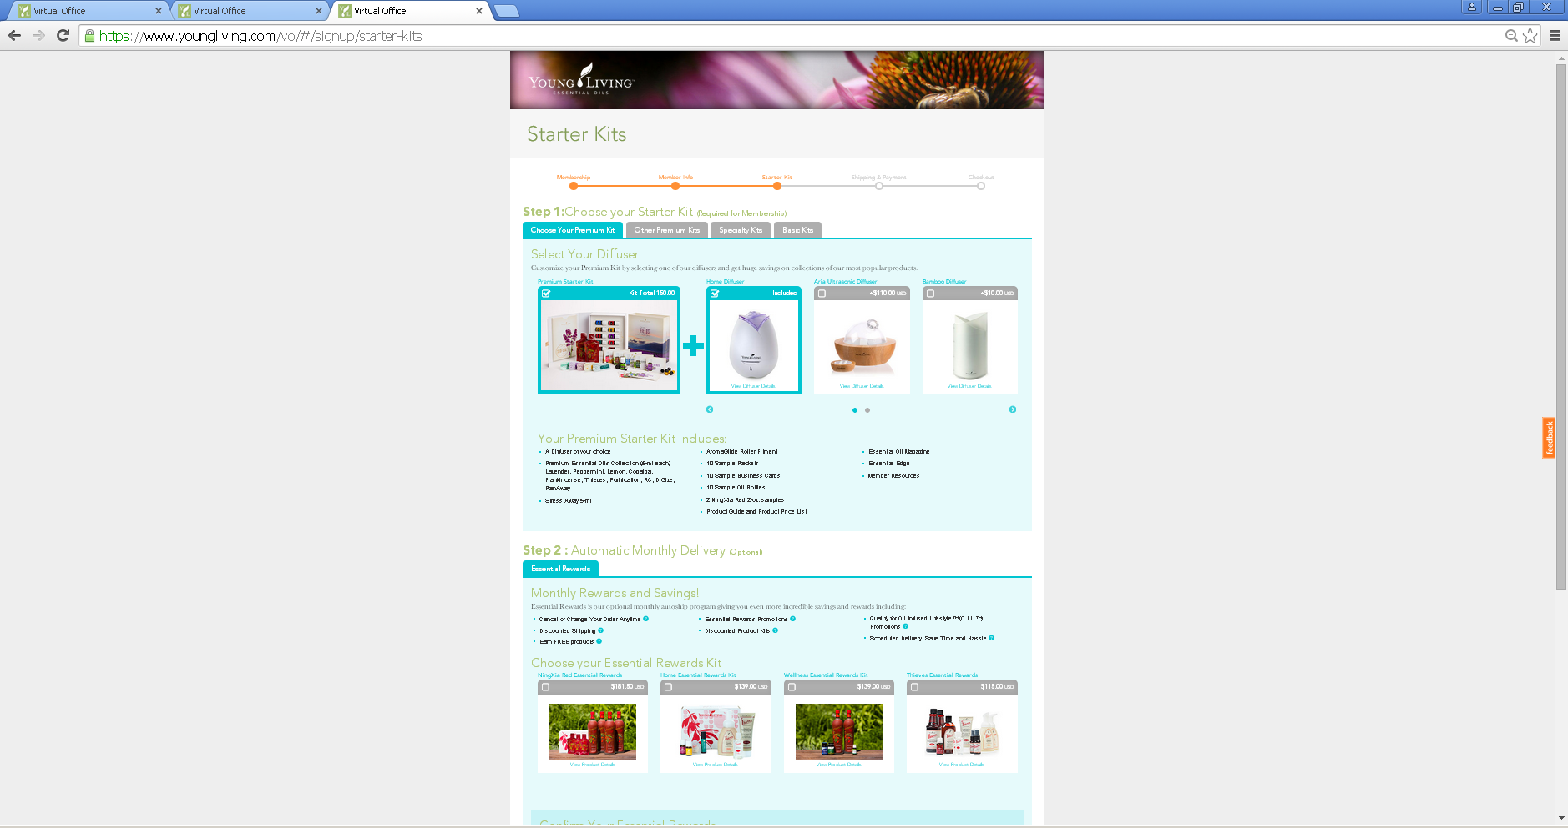
Customize your Premium Starter Kit by selecting your diffuser and Essential reward kit ( if desired ).

Slide 4
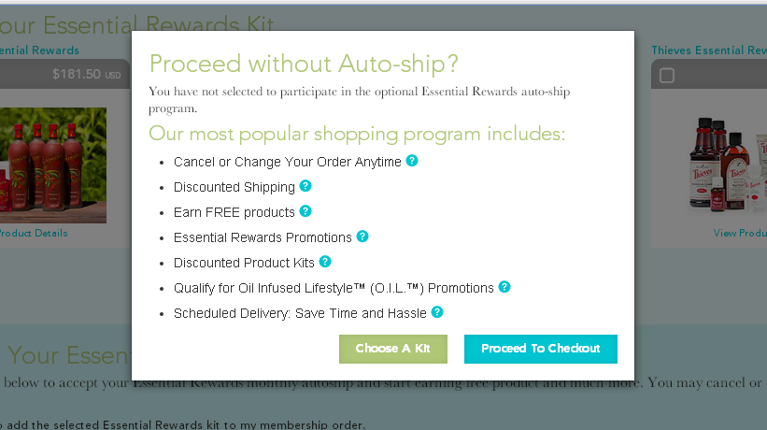
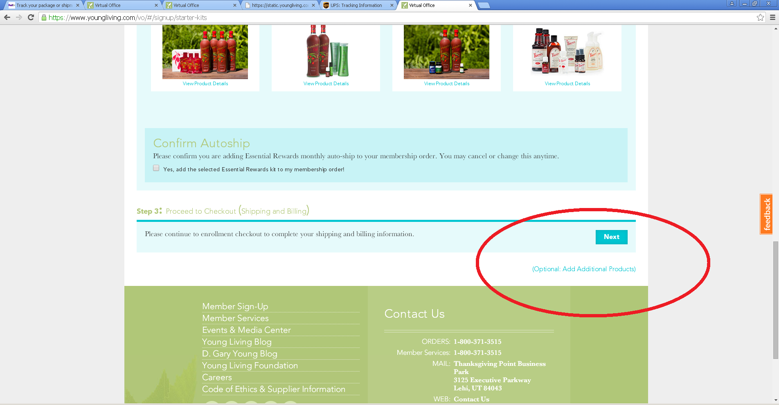
If you don’t select an ESSENTIAL REWARDS KIT a confirmation window like this will pop out, if you don’t wish to set up your Essential Rewards at the time you can click PROCCEED TO CHECK OUT.
You can also add additional products to this order clicking on ADDITIONAL PRODUCTS at the bottom right corner when done click NEXT ( bottom right corner).

Slide 5
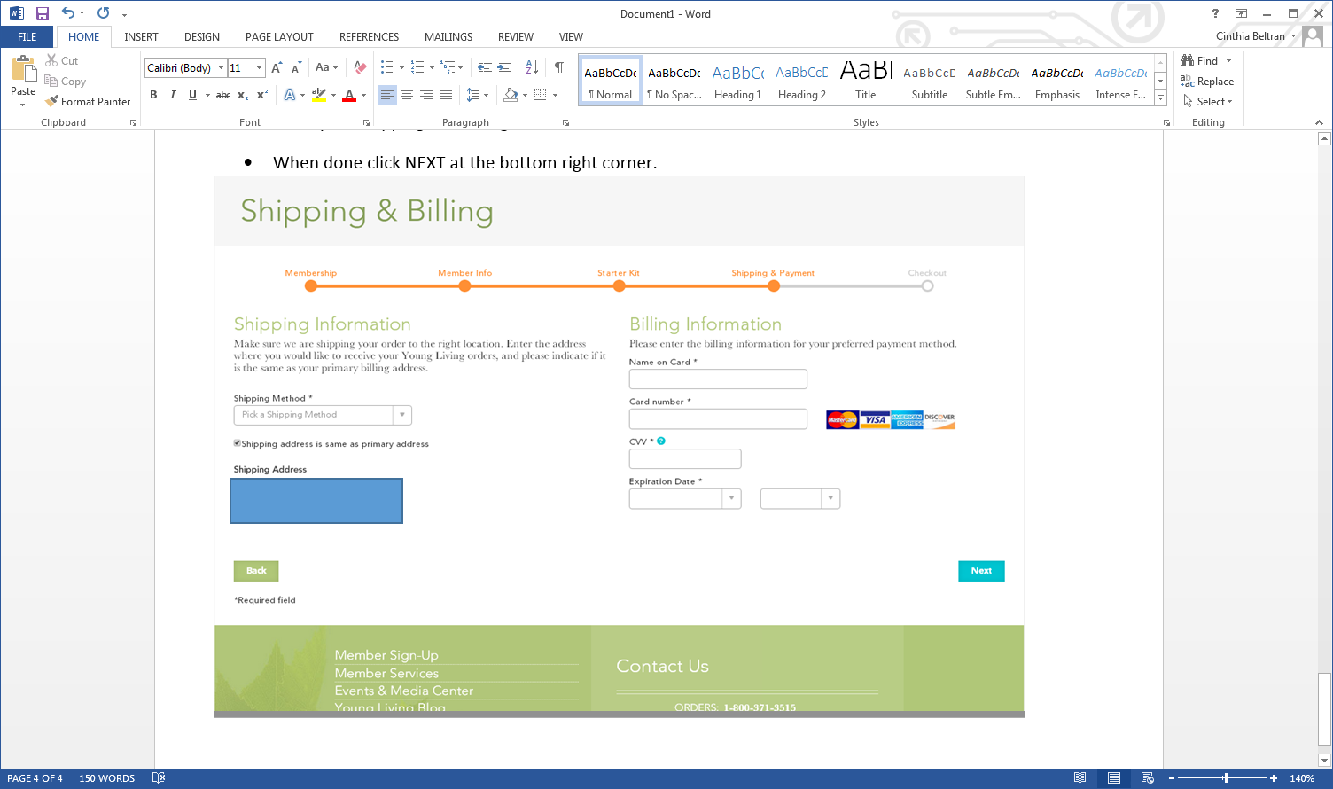
Enter your shipping and Billing information.
When done Click next at the bottom right corner.

Slide 6
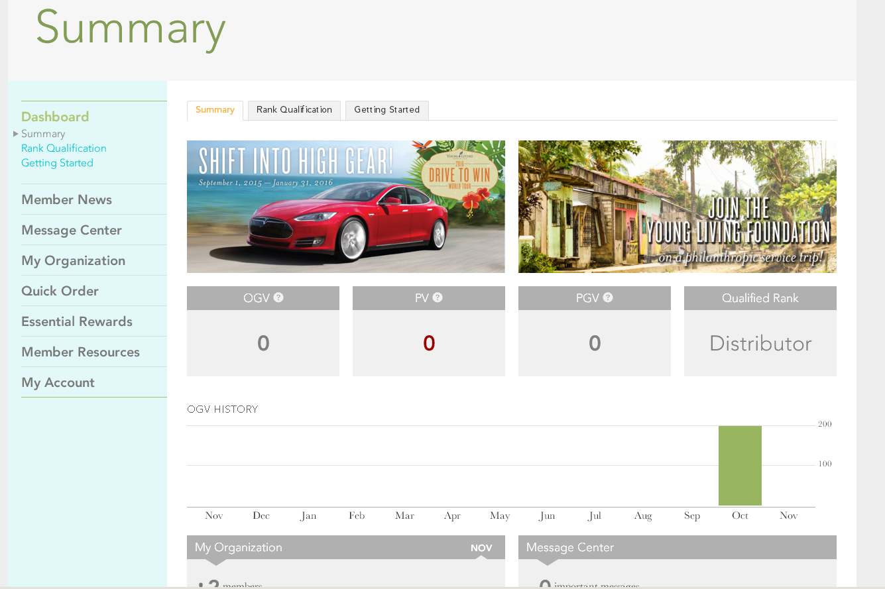
Welcome to your Virtual Office!
Once you have entered all of your member information you will be able to see your Summary and you account information.

